Slide 1
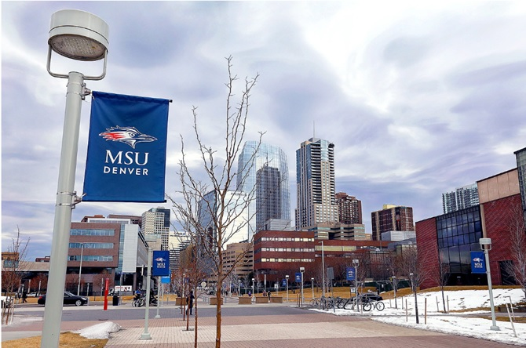
Effectiveness of Nutrition Education Classes on Knowledge and Food Preparation Confidence
NUT 5090 | Claire Margolf, Kaimanlin Yao, Lexi Keller, and Natalie Martens

Slide 2
Table of Contents
⋅ 01 ⋅
⋅ 04 ⋅
Background
Interventions
⋅ 02 ⋅
⋅ 05 ⋅
RQ and Hypothesis
Evaluation & Data Analysis
⋅ 03 ⋅
⋅ 06 ⋅
Methodology
Dissemination of Results

Slide 3
Background
Our research study is taking place in the Denver metro neighborhood of Sun Valley.
Sun Valley is characterized by high poverty, low socioeconomic status, low education, and limited access to healthy foods in Denver.¹
The Sun Valley Healthy Living Initiative was established in 2019 to positively impact residents’ social, emotional, financial and nutritional health.¹
The purpose of our study is to examine effectiveness of a one-time nutrition education class and meal kit offering on nutrition knowledge and meal preparation effects confidence level in low-income families.

Slide 4
Why Sun Valley?
Low employment rate.
36% of residents are unemployed.¹
Lack of access to fresh food resources.
42% of residents have trouble accessing fresh foods.¹
Barriers to receiving healthcare.
49% of adults and 68% of children report having had a preventative care visit. Residences at higher risk for chronic diseases.¹

Slide 5
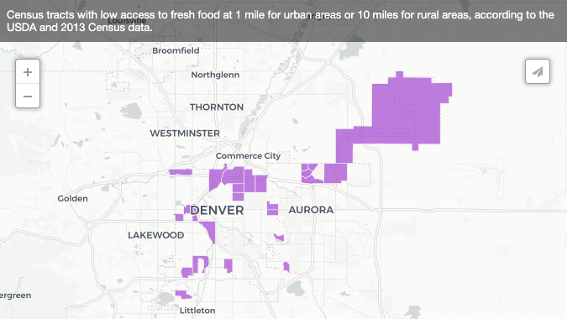
Food Deserts Defined:
An area where people have limited access to diverse, healthful food.
An area with a poverty rate of ≥ 20%,² i.e. a household with income less than the Federal poverty level: $27,750 for a family of 4 in 2022.³
The higher the percentage of minority
population, the more likely the area is
to be a food desert.²
Urban areas: at least 33% of the population
lives more than 1 mile from the nearest
supermarket.⁴
Map: Dean, A. (2016, October 19). Here’s where Denver’s food deserts are, and what the city is doing about them. Denverite. https://denverite.com/2016/10/19/denver-food-deserts/

Slide 6
Research Question and Hypothesis
Hypothesis:
A one-time nutrition education class and meal kit offering will increase nutrition knowledge and confidence in the ability to purchase and prepare healthy foods.
Null-Hypothesis:
A one-time nutrition education class and meal kit offering will elicit no difference in nutrition knowledge and confidence in the ability to purchase and prepare healthy foods.
RQ:
How effective is a one-time nutrition education class and meal kit offering on changing nutrition knowledge and meal preparation confidence for low-income families in Sun Valley?

Slide 7
Literature Review Focus Points
Important Components of Nutrition Education Programs
Benefits of Nutrition Education Programs
Possible Barriers and Limitations of Nutrition Education Programs

Slide 8
Research timeline:
Nov 12th 2022
Dec 7th 2022
Mar 13th- May 13th 2023
Research team submitted IRB.
- The team attended the nutrition education class at the Sun Valley People Center.
- Research team distributed and collected informed consent, pre, and post class surveys.
Jan 17th- Mar 11th 2023
Nov 22nd 2022
- In NUT 5092, the team will draw final conclusions and write study paper.
- Present the study at the end-of-semester Nutrition Research Day.
- The IRB approved our study.
- Free nutrition class and meal kit fliers placed on doors of
Sun Valley residences.
- In NUT 5091, the team will focus on organizing, analyzing, and interpreting the data.

Slide 9
Methodology
Recruit Participants
Flyers promoting cooking class and meal kit presentation on Dec. 7th are posted on doors of Sun Valley residents.
Prior to the Intervention
Research team distributes pre-survey to collect baseline data about participants nutrition knowledge and confidence in cooking.
Intervention
A 45-minute basic cooking class with an additional nutritional education component on fiber.
Post-intervention
Deliver a post-survey to measure the effectiveness of the nutritional based cooking class.
4
Data Analysis
Compare pre/post survey data for possible improvement in nutrition knowledge and cooking confidence.

Slide 10
Study Subjects
Inclusion
Exclusions
Risk to Subjects
- Adults residents from the Sun Valley Community.
- Residents who signed up to participant in the meal kit activity and the graduate research.
* Women who are pregnant can participate in this study because there is minimal risk.
Under 18 years old.
* People with food allergies can participate in the research study, they would not take a meal kit home.
- There will be minimal/no risk to the subjects.
- Subjects may experience discomfort when answering some questions related to food insecurity.

Slide 11
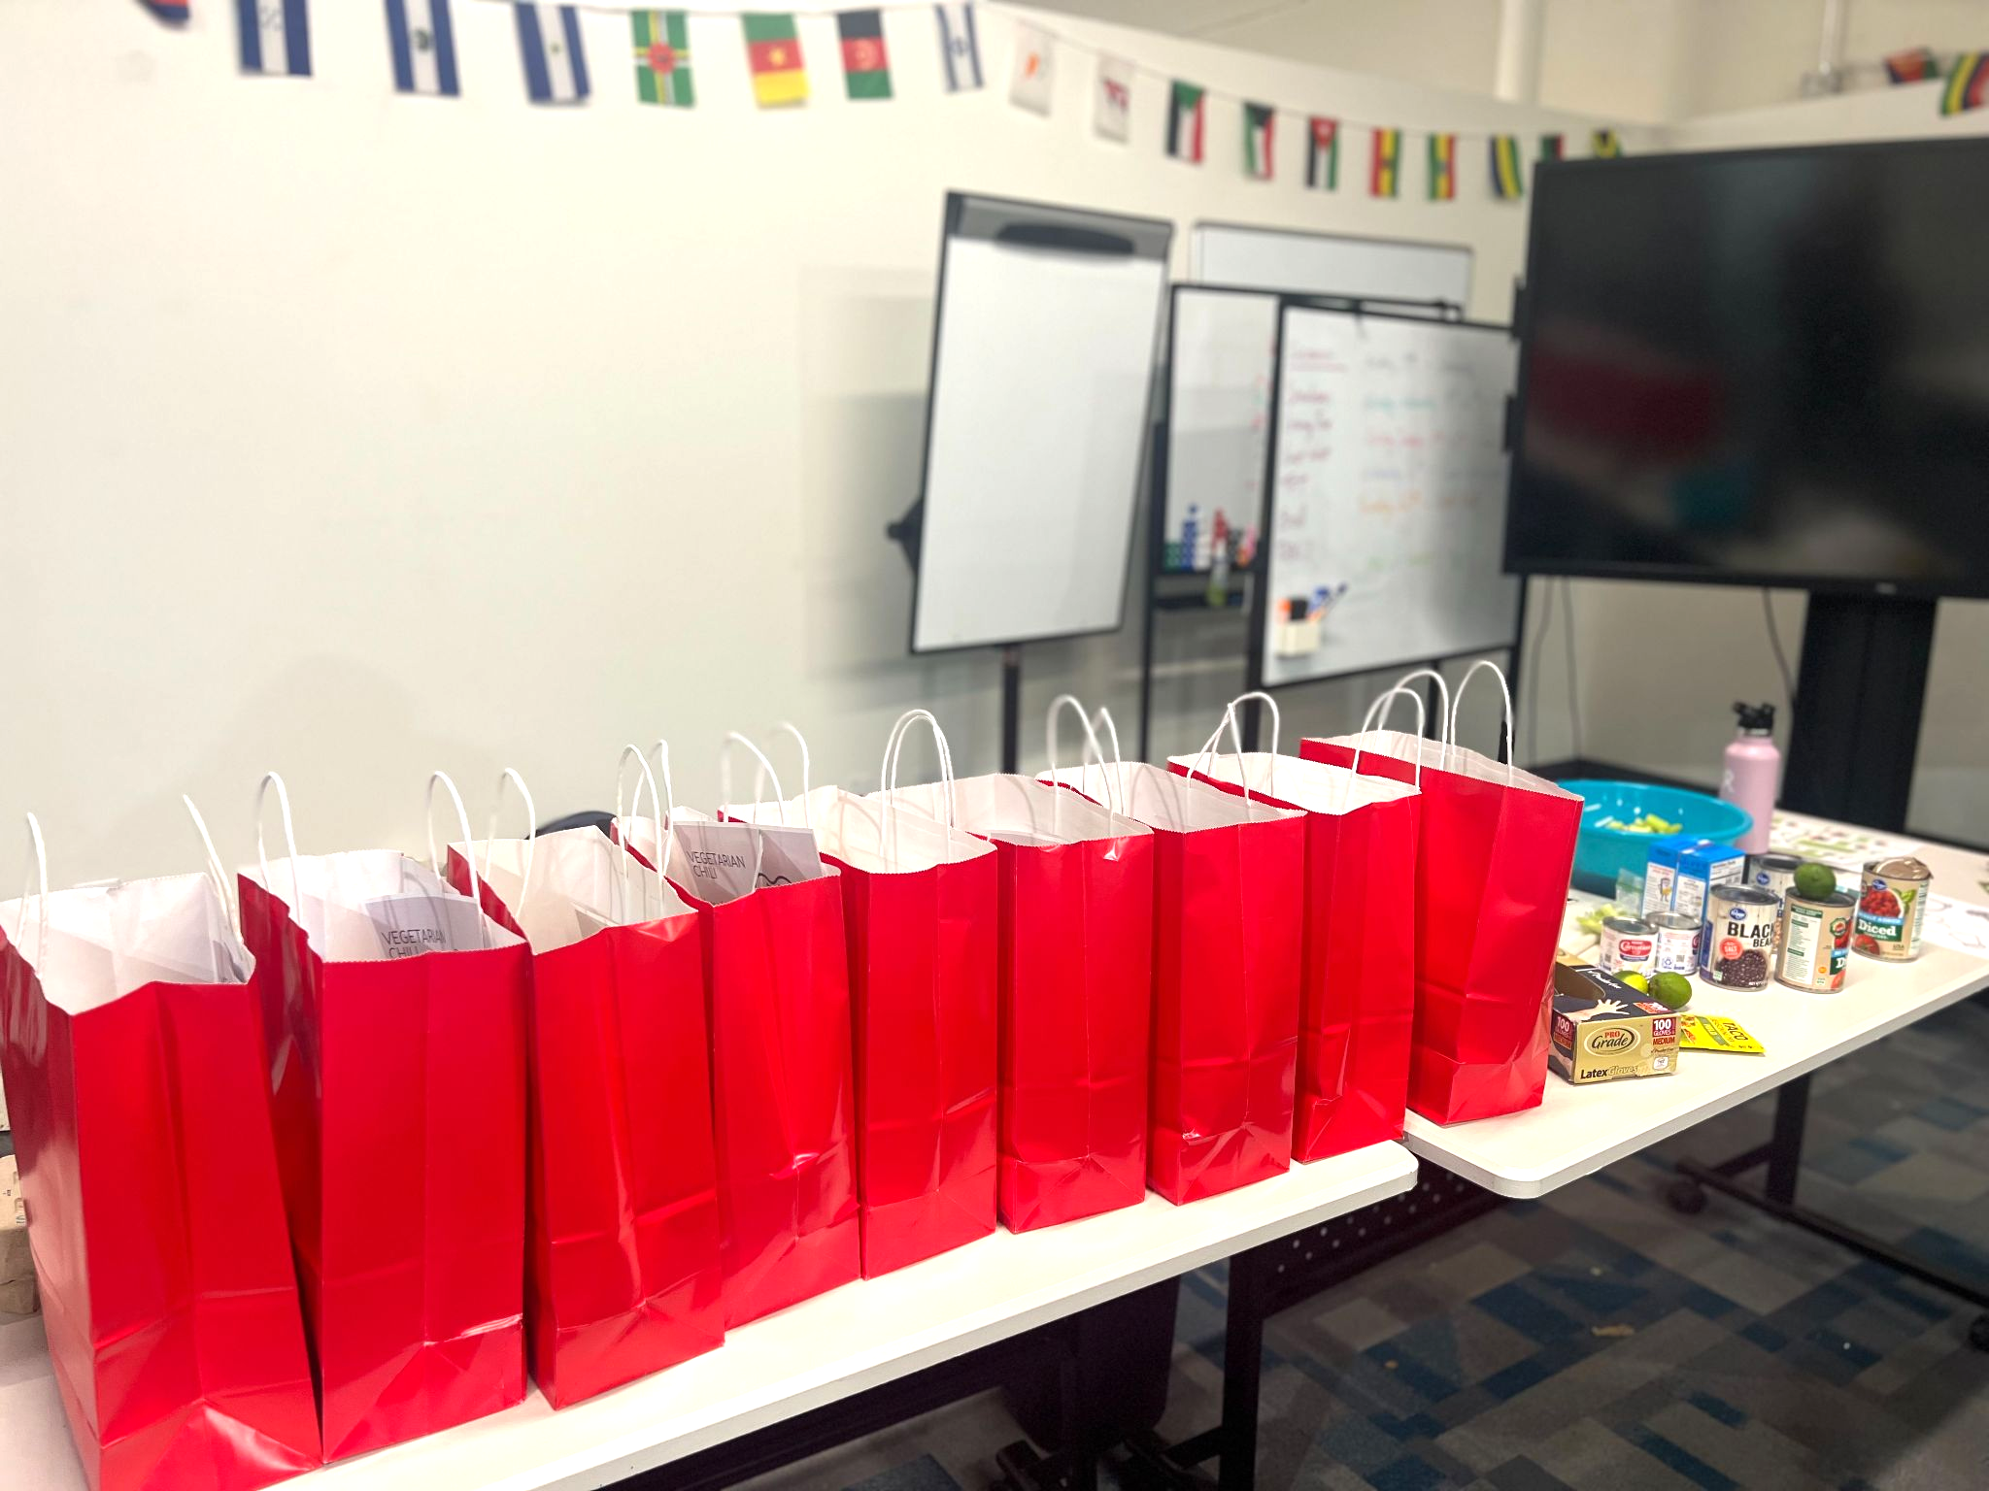
Intervention
45 minute basic cooking and nutrition knowledge class delivery by NUT 5020 students. Topics covered:
  Nutritional facts and benefits of ingredients used.
  Demonstrate different varieties of the dish.
  Explanation of fiber, and foods that contain fiber.
  How to grocery shop with limited budget.
A take home meal kit that includes all the ingredients for a vegetarian chili dish for a family.

Slide 12

Surveys
A pre- class & post-class survey. Anonymous, in-person, ~10 minutes to complete.
Surveys assess:
Demographic information
Confidence in shopping for healthy foods
Confidence in preparing & cooking food for the household
Adequate cooking equipment
Food Insecurity
Inflation affecting food purchasing habits
Questions adapted from these validated surveys:
International Food Information Council. 2021 Food & Health Survey. 19 May 2021. https://foodinsight.org/2021-foodhealth-survey/
U.S. Household Food Security Survey Module: Six-Item Short Form Economic Research Service, USDA, September 2012. https://www.ers.usda.gov/media/8282/short2012.pdf

Slide 13
Data Collection and Analysis
The pre-cooking class surveys are collected before the cooking class starts. Post-class surveys are collected as participants leave.
Data will be coded and entered into an Excel spreadsheet with no names – only numerical subject codes.
Data will be analyzed using SPSS. Descriptive statistics and paired t-tests will be used to analyze pre and post survey responses.

Slide 14
Dissemination of Results
Present the study at the End-of-semester Nutrition Research day in May, 2023.
Deliver the study results in research practicum 5092 class.

Slide 15
Thanks for listening!
Questions?

Slide 16
References
Sun Valley Health Needs Assessment Overview (Healthy Living Initiative Action Plan). (2019). Denver Housing Authority. https://www.sunvalleyredevelopment.com/_files/ugd/676bbd_50785d99e7ef403fbd228422fde97bc1.pdf
Dutko, Paula, Michele Ver Ploeg, and Tracey Farrigan. Characteristics and Influential Factors of Food Deserts, ERR-140, U.S. Department of Agriculture, Economic Research Service, August 2012. https://www.ers.usda.gov/webdocs/publications/45014/30940_err140.pdf
Federal Poverty Level (FPL) - Glossary. (n.d.). HealthCare.Gov. Retrieved December 14, 2022, from https://www.healthcare.gov/glossary/federal-poverty-level-fpl
Caporuscio, J. (2020, June 22). Food deserts: Definition, effects, and solutions. Medical News Today. https://www.medicalnewstoday.com/articles/what-are-food-deserts

