Slide 1

RQ:
Does Magnesium Supplementation Improve Insomnia in Elderly People ?
KAIMANLIN YAO
NUT 5080
Dr. Sinley

Slide 2
Overview
1
3
5
Introduction
2
Results
4
Conclusion
Methology
Discussion

Slide 3
What is Insomnia?
Unsatisfactory quality and quality of sleep.
Medical / nonmedical treatments.
aging
Underline health issues.
Lacks of treatment guidelines.
Certain types of medicine
Decreased sleep duration
Stress
Short term / chronic

Slide 4
Why Insomnia Matter?
Major risks factor for depression
Decreasing quality of life in elders.
~ 2/3 Undiagnosed
Increased car accident rate.
>50%
Effects of Insomina
10~48%
Cognitive impairment
> 60 yrs old
All population
Weak physical functions

Slide 5
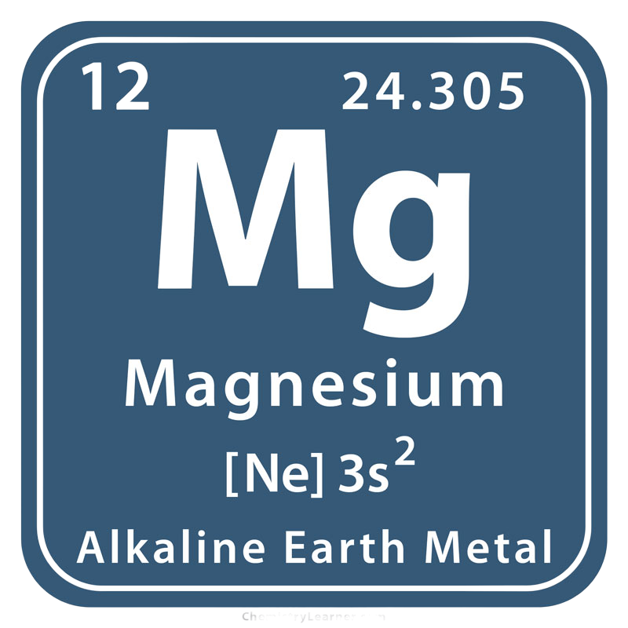
Magnesium
Involve > 300 biochem reactions within our body.
Especially energy metabolism and neurotransmitters synthesis
Aging --- affects magnesium status.
Neural transmission.
The natural antagonist of NMDA and agonist of GABA.

Slide 6
Study Criteria
Inclusion:
Primary insomnia
Magnesium intake < 75% RDA.
Exclusion:
Breathing-related sleep disorder.
Sleep disorder due to medical conditions.
Neurological disorder. Depression.
Using of beta-blocker.
Restless leg syndrome.

Slide 7
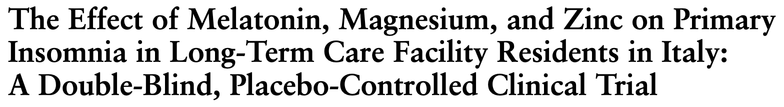
Study Design
8 wks. Randomized, double-blind clinical trial.
100g Pear pulp mix with melatonin(5 mg), magnesium (225mg), and zinc ( 11.25mg). 1 hr before bedtime.

Slide 8
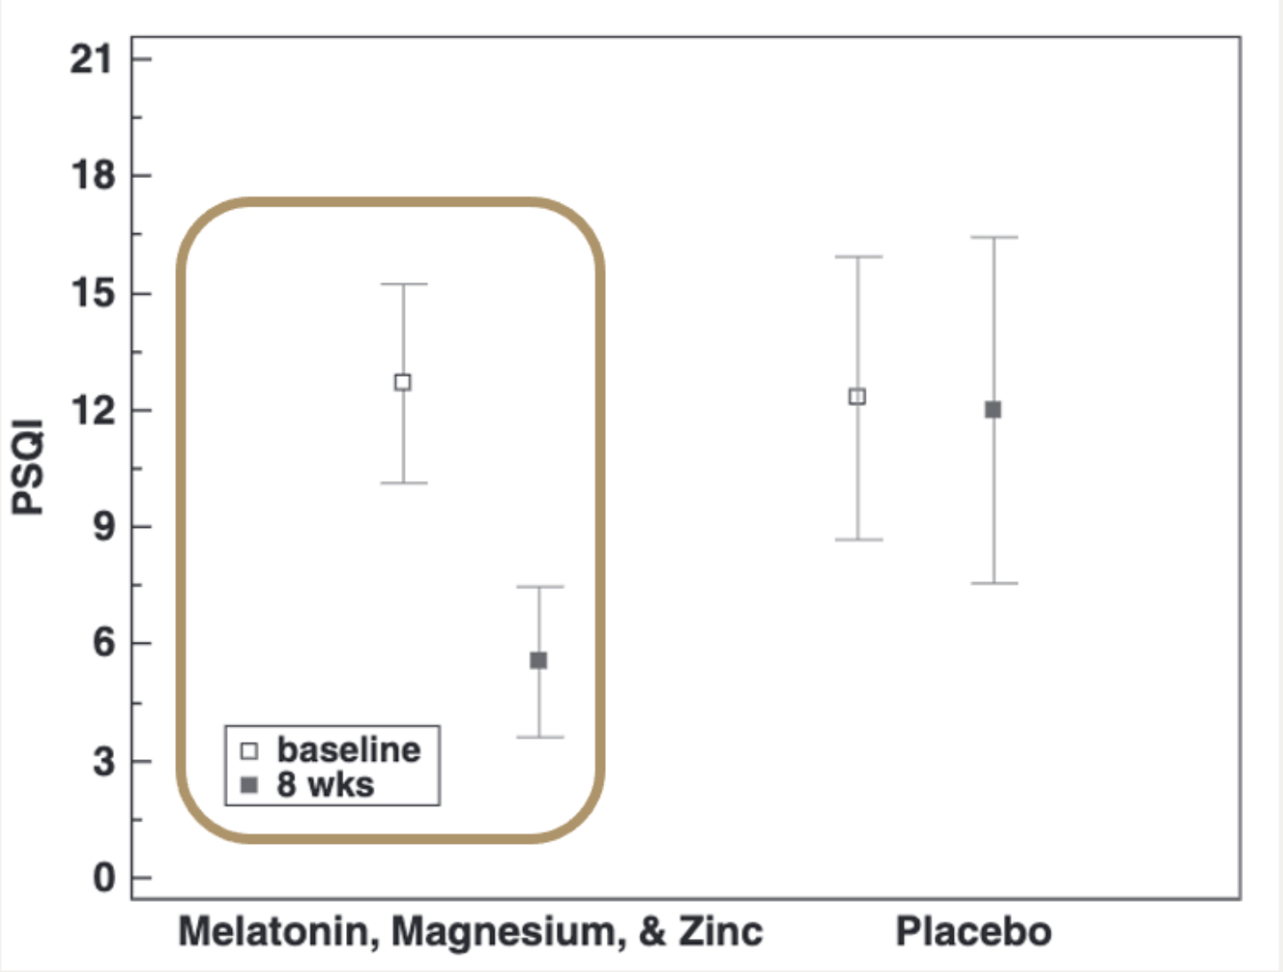
Study I Results
The mixture of melatonin, magnesium, and zinc of pear pulp:
↓ PSQI score by 6.8 points.
↑ Total sleeping number.
↑ Daily steps.
↓ BMI
Daily Steps

Slide 9
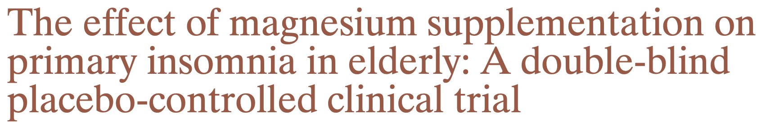
Study Design
(Confounding factors included)
doubled-blind randomized 8 wks clinical trial.
Oral intake of 250 mg magnesium oxide tablets. (2 times/day)

Slide 10
Study II Results

Slide 11
Discussion & Future Study Ideas
A higher dose of melatonin was added.
Small sample size (43 people). Particular study group.
Subjective results.
A mixture of 3 supplementations.
Study I:
Limitations of The Two Studies
Study II:
Small sample size.

Slide 12
Conclusion

Slide 13

Sleeping is The Best Medicine.

Slide 14
Thanks!
Reference
Abbasi, B., Kimiagar, M., Sadeghniiat, K., Shirazi, M. M., Hedayati, M., & Rashidkhani, B. (2012, December). The effect of magnesium supplementation on primary insomnia in elderly: A double-blind placebo-controlled clinical trial. Journal of research in medical sciences : the official journal of Isfahan University of Medical Sciences. Retrieved September 22, 2022, from https://www.ncbi.nlm.nih.gov/pmc/articles/PMC3703169/
Rondanelli, M., Opizzi, A., Monteferrario, F., Antoniello, N., Manni, R., & Klersy, C. (2011). The effect of melatonin, magnesium, and zinc on primary insomnia in long-term care facility residents in Italy: A double-blind, placebo-controlled clinical trial. Journal of the American Geriatrics Society, 59(1), 82–90. https://doi.org/10.1111/j.1532-5415.2010.03232.x

