Slide 1
Polyunsaturated Fatty Acids
and Multiple Sclerosis (MS)
Presenter: KAIMANLIN YAO
NUT 5081

Slide 2
Overviews
Introduction
Discussion
Methodology
Conclusion
Study Results

Slide 3
Introduction
💰
Unknown Causes
Women at More Risk
Expensive To Treat
Cost of immunomodulatory therapies: > $ 25,000
(Interferon β-1a treatment)
20~ 40 yrs old. Women has 4 times more likely to developing MS than men.
Risk factors: Low level Vitamin.D; Virus; Some autoimmune diseases.

Slide 4
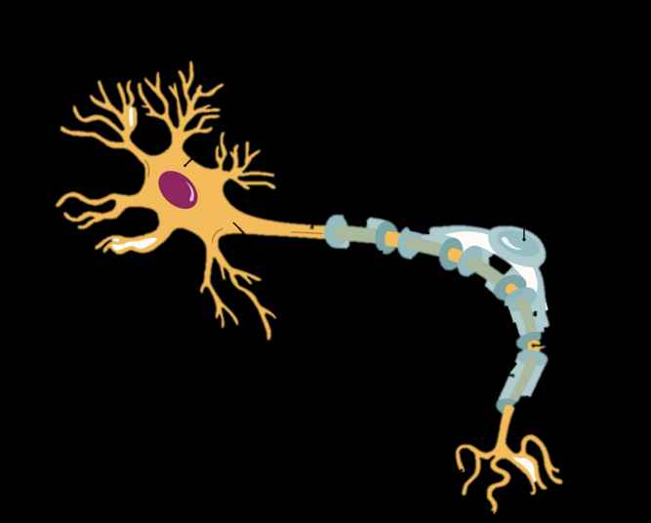
Etiology of MS
Multiple Sclerosis:
An inflammatory and neurodegenerative disease in CNS.
Demyelinating
Axon
Myelin Sheath
Healthy Neuron
MS Neuron

Slide 5
RQ:
Main: What Potential Therapeutic Role Of Polyunsaturated Fatty Acids Play In Relapsing-Remitting Multiple Sclerosis (RRMS) ?
Sub-Q:
1.How polyunsaturated fatty acids improve or slow the progression of condition of MS diseases?
2. Are there difference between plant-based or animal sources of polyunsaturated fatty acids?

Slide 6
Study Criterias
4 Primary studies
4 Reviews articles
Aged between 18 ~ 65 years old.
Disability score EDSS ≤ 5.0.
people diagnosed with relapsing-remitting MS
Significant medical condition ( cancer, cerebrovascular diseases)
Supplementation with Ω-3,6
fatty acid last three mths
Server physical impairment
Studies
Inclusion
Exclusion

Slide 7
Study Methods
Supplementation of Ω-3, 6 fatty acid to examine Quality of overall gait. 6-minute walk test, both hands max- handgrip strength. Max voluntary strength of both legs.
Effectiveness of Ω-3 fatty acid supplementation on MRI activity and EDSS scoring.
Effectiveness of α-Linolenic acid fatty acid(ALA) supplementation on MRI activity and EDSS scoring.
Using of Ω-3,6 supplementation to examine MMP-9 level

Slide 8
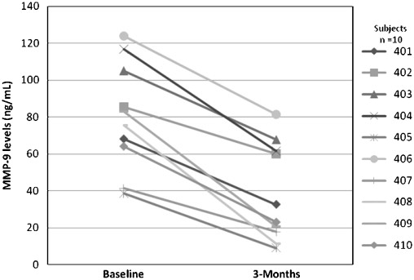
Study Results
Physical Parameters
significant ↑ walking distance from 505 m at baseline to 546m.
Improvement walking gesture.
Sit-to-stand,5- repetitions test both decreased. Omega group time had aggressive ↓.
MMP-9 transport inflammatory cells into CNS.

Slide 9
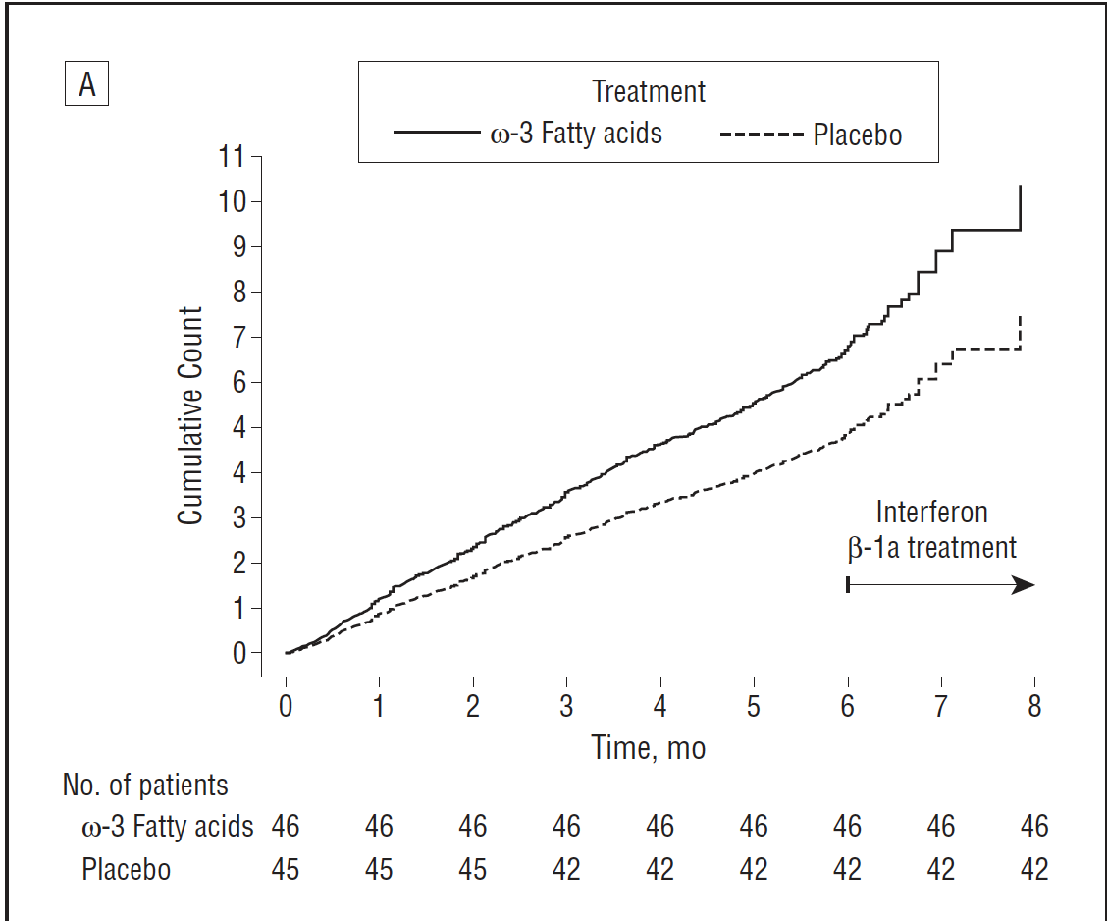
MRI Parameters
Animals Sourced Ω-3
Planted Based Ω-3 (ALA)
MRI
No significant decrease disease activity
↓ Odds of MRI activity and T2-lesions
Total time of relapses
no difference
No report
EDSS score
1.86 to 1.87 (statistical significance)
MRI T1 lesion from Animals Sourced Ω-3 supplementation.
Decreased EDSS scoring.

Slide 10
Discussion
Overall, most of the studies showed Polyunsaturated F.A improved medical conditions and physical impairment in MS patients.
Limitation:
Sample size did not meet sufficient power to detect effectiveness in different dosage.
Small sample size can increase likelihood of study results due to chance.
Treating MS patients with only Ω-3 supplementation and placebo without interferon β, it might consider as ethical problem.
Selected participants are not represent the general population.

Slide 11
Conclusion
Multiple sclerosis is a chronic demyelinating disease of CNS.
At the present time, causes of MS is unknown.
3 studies showed polyunsaturated fatty acids has positive effect on improving RRMS conditions.
1 study showed animal based polyunsaturated fatty acids did not have effect on RRMS.
Immunomodulatory and anti-inflammatory effect of polyunsaturated fatty acids can combine with current pharmacological therapies to improve life quality in MS patients.

Slide 12
References
Aristotelous, P., Stefanakis, M., Pantzaris, M., Pattichis, C. S., Calder, P. C., Patrikios, I. S., Sakkas, G. K., & Giannaki, C. D. (2021). The effects of specific omega-3 and omega-6 polyunsaturated fatty acids and antioxidant vitamins on gait and functional capacity parameters in patients with relapsing-remitting multiple sclerosis. Nutrients, 13(10), 3661. https://doi.org/10.3390/nu13103661
Mahad, D. H., Trapp, B. D., & Lassmann, H. (2015). Pathological mechanisms in progressive multiple sclerosis. The Lancet Neurology, 14(2), 183–193. https://doi.org/10.1016/s1474-4422(14)70256-x
Mehta, L. R., Dworkin, R. H., & Schwid, S. R. (2009). Polyunsaturated fatty acids and their potential therapeutic role in multiple sclerosis. Nature Clinical Practice Neurology, 5(2), 82–92. https://doi.org/10.1038/ncpneuro1009
MK;, H. L. S. S. (n.d.). Polyunsaturated fatty acids in the pathogenesis and treatment of multiple sclerosis. The British journal of nutrition. Retrieved November 20, 2022, from https://pubmed.ncbi.nlm.nih.gov/17922959/
Shinto, L., Marracci, G., Baldauf-Wagner, S., Strehlow, A., Yadav, V., Stuber, L., & Bourdette, D. (2009). Omega-3 fatty acid supplementation decreases matrix metalloproteinase-9 production in relapsing-remitting multiple sclerosis. Prostaglandins, Leukotrienes and Essential Fatty Acids, 80(2-3), 131–136. https://doi.org/10.1016/j.plefa.2008.12.001
Torkildsen, Ø. (2017). Α-linolenic acid (ALA) serum levels are associated with reduced MRI activity in a prospective cohort of ms patients. https://doi.org/10.26226/morressier.59a3e8b4d462b8028d894357
Torkildsen, Ø., Wergeland, S., Bakke, S., Beiske, A. G., Bjerve, K. S., Hovdal, H., Midgard, R., Lilleås, F., Pedersen, T., Bjørnarå, B., Dalene, F., Kleveland, G., Schepel, J., Olsen, I. C., & Myhr, K.-M. (2012). Ω-3 fatty acid treatment in multiple sclerosis (OFAMS study). Archives of Neurology, 69(8). https://doi.org/10.1001/archneurol.2012.283
van Meeteren, M. E., Teunissen, C. E., Dijkstra, C. D., & van Tol, E. A. F. (2005, August 24). Antioxidants and polyunsaturated fatty acids in multiple sclerosis. Nature News. Retrieved November 20, 2022, from https://www.nature.com/articles/1602255

Slide 13
Questions
Thank you!

